Slide 1

E6156 – Cloud Computing:
Backend-as-a-Service
Lecture 10: Overall Site Company Image, API GW, OAuth2, Facebook Login, API Gateway Authorizer
Donald F. Ferguson dff9@Columbia.edu
TRANSCENDING DISCIPLINES, TRANSFORMING LIVES

Slide 2

We will start in a couple of minutes.
2 | E6156 – Cloud Computing: Backend-as-a-Service: Lecture 8

Slide 3
Single Site Image Certificate, DNS, CloudFront, API Gateway
3 | E6156 – Cloud Computing: Backend-as-a-Service

Slide 4
Domain Names and URLs
You have seen that deploying microservices and endpoints can result in some strange URLs. For example, some of mine are:
API GW: https://y9id42n6b0.execute-api.us-east-1.amazonaws.com/
Static content: https://e6156f20site.s3.us-east-2.amazonaws.com/WebSite/
EC2 Flask endpoint: ec2-3-86-201-238.compute-1.amazonaws.com
http://e6156products-env.eba-q3nrc2nh.us-east-1.elasticbeanstalk.com/ (Note: This is not HTTPs, and insecure).
These DNS names are “weird” and do not look like they come from a common company or organization.
Your probably want something like:
https://www.dff-e6156.org/index.html
https://api.dff-e6156.org/users
https://api.dff-e6156.org/accounts
... ...
Accomplishing this requires:
A domain.
Certificates for the domain.
DNS entries.
Routing front end that routes to actual endpoints based on URL and path.

Slide 5
Domain Names and URLs
Setting all of this up can be tedious and error prone.
Not as tricky as ECS, but still unpleasant.
Also, this is cloud
Infrastructure design and management.
Not cloud application development.
These are different roles and teams in most cases.
Basic familiarity with the concepts is helpful.
We will not have detailed milestones/tasks on these topics but will do a little work.
You have seen that deploying microservices and endpoints can result in some strange URLs. For example, some of mine are:
API GW: https://y9id42n6b0.execute-api.us-east-1.amazonaws.com/
Static content: https://e6156f20site.s3.us-east-2.amazonaws.com/WebSite/
EC2 Flask endpoint: ec2-3-86-201-238.compute-1.amazonaws.com
http://e6156products-env.eba-q3nrc2nh.us-east-1.elasticbeanstalk.com/ (Note: This is not HTTPs, and insecure).
These DNS names are “weird” and do not look like they come from a common company or organization.
Your probably want something like:
https://www.dff-e6156.org/index.html
https://api.dff-e6156.org/users
https://api.dff-e6156.org/accounts
... ...
Accomplishing this requires:
A domain.
Certificates for the domain.
DNS entries.
Routing front end that routes to actual endpoints based on URL and path.

Slide 6
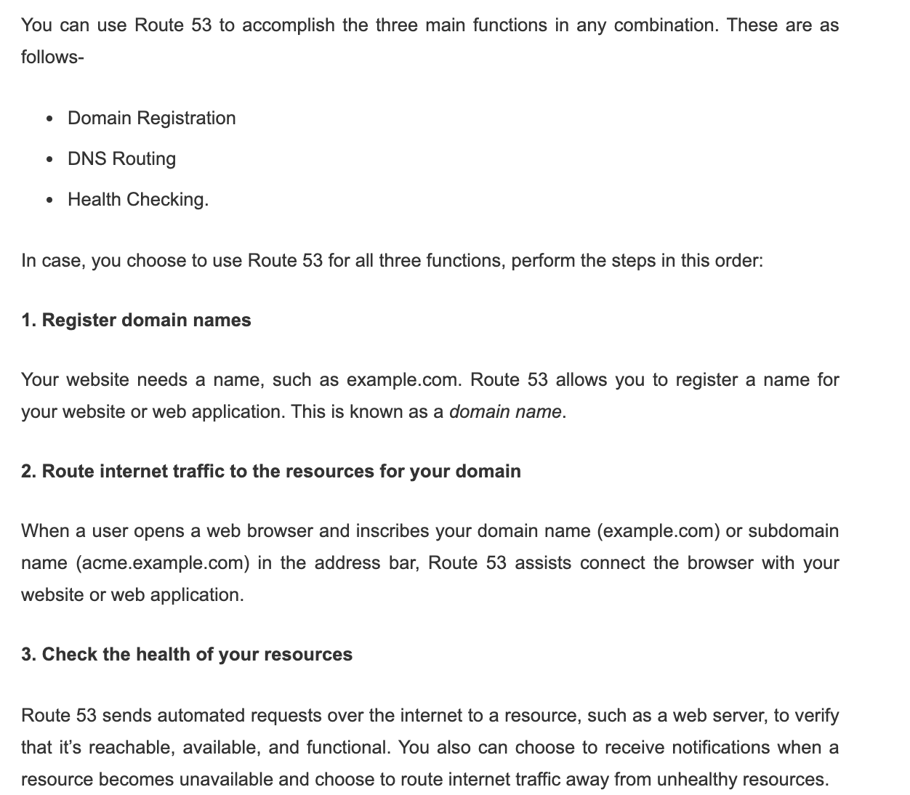
Domain and Route 53
“The Domain Name System (DNS) is a hierarchical and decentralized naming system for computers, services, or other resources connected to the Internet or a private network. It associates various information with domain names assigned to each of the participating entities. Most prominently, it translates more readily memorized domain names to the numerical IP addresses needed for locating and identifying computer services and devices with the underlying network protocols. ... ... The Domain Name System delegates the responsibility of assigning domain names and mapping those names to Internet resources by designating authoritative name servers.”

Slide 7
Domain and Route 53
Let’s create a domain ... ...
Route to the WordPress I created.
Show insecure.

Slide 8
HTTPS
Hypertext Transfer Protocol Secure (HTTPS) is an extension of the Hypertext Transfer Protocol (HTTP). It is used for secure communication over a computer network, and is widely used on the Internet ... ...
The principal motivations for HTTPS are authentication of the accessed website, and protection of the privacy and integrity of the exchanged data while in transit. ... ...
The authentication aspect of HTTPS requires a trusted third party to sign server-side digital certificates. ... ... HTTPS is now used more often by web users than the original non-secure HTTP, primarily to protect page authenticity on all types of websites; secure accounts; and to keep user communications, identity, and web browsing private.

Slide 9
HTTPS Protocol
HTTPS is essential to privacy, integrity and avoid “man in the middle.”
HTTPS requires a digital certificate.
The client must trust the certificate authority that issues the certificate to the server site.

Slide 10
HTTPS Protocol – And Certificate
Show some stuff in the browser.
Trusted site.
My WordPress site.
Make a certificate.
Show Elastic Load balancer. (That was fun ... ...)
I did not go through all of the steps
I am lazy.
This is cloud infrastructure management.
You get the idea.
I am lazy.

Slide 11
CloudFront and Content
Content Delivery Networks vastly improve performance for web sites.
Can also improve performance for REST APIs
Response caching for common API requests, e.g.
“Top 10 most active stocks ...”
Career batting stats for Ted Williams.

Slide 12
Cloud Front
Set up a distribution.
Configure certificate.
Configure S3 distribution.
Configure API endpoint: EC2, Lambda https://api2.dff-e6156.org/simple-flask/health

Slide 13
OAuth2 and Facebook Login
13 | E6156 – Cloud Computing: Backend-as-a-Service

Slide 14
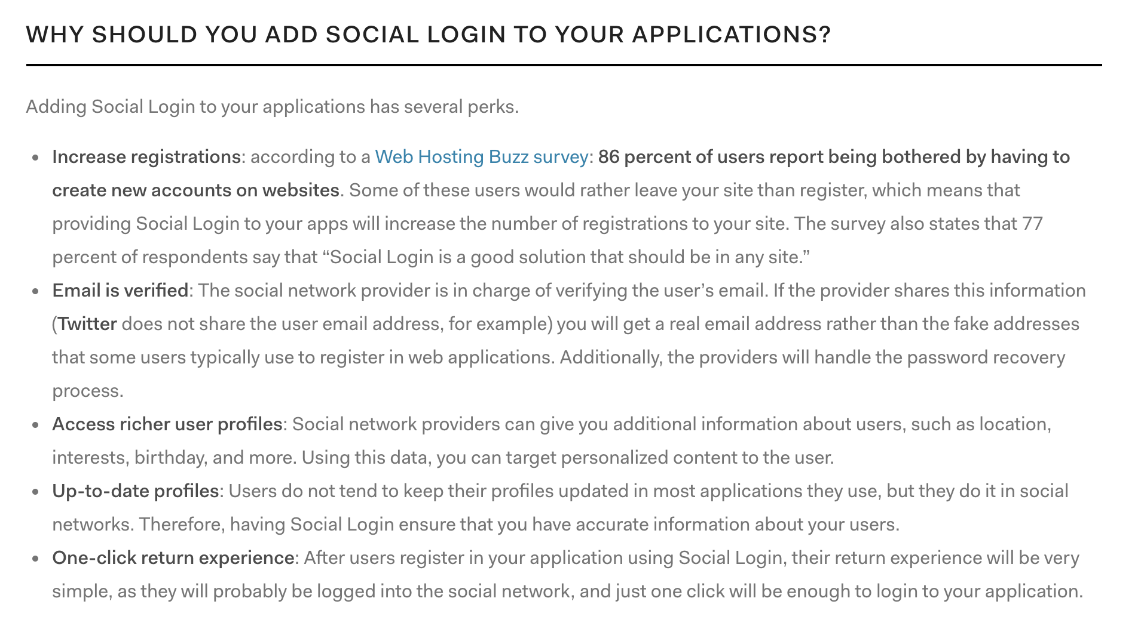
Social Media Login

Slide 15
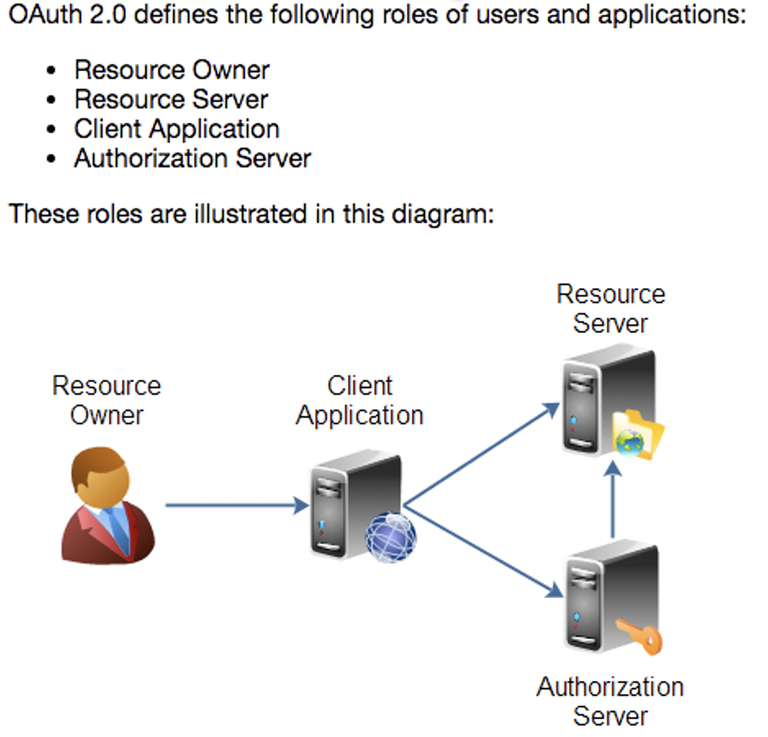
OAuth2
Resource Owner
Controls access to the “data.”
Facebook user, LinkedIn user, …
Resource Server
The website that holds/manages info.
Facebook, LinkedIn, ...
And provides access API.
Client Application
“The product you implemented.”
Wants to read/update
“On your behalf”
The data the data that the Resource Server maintains, e.g. posts, status, tweets, ...
Authorization Server
Grants/rejects authorization
Based on Resource Owner decisions.
Usually (logically) the same as Resource Server.
http://tutorials.jenkov.com/oauth2/index.html

Slide 16
OAuth2 – Facebook
There are a couple of different flows for Facebook.
There is a client centric one.
Will show more of the full, server flow.

Slide 17
Demo
Facebook application definition.
Test users.
Code walkthrough.
Server side
Controller

Slide 18
API Gateway Authorizer
18 | E6156 – Cloud Computing: Backend-as-a-Service

Slide 19
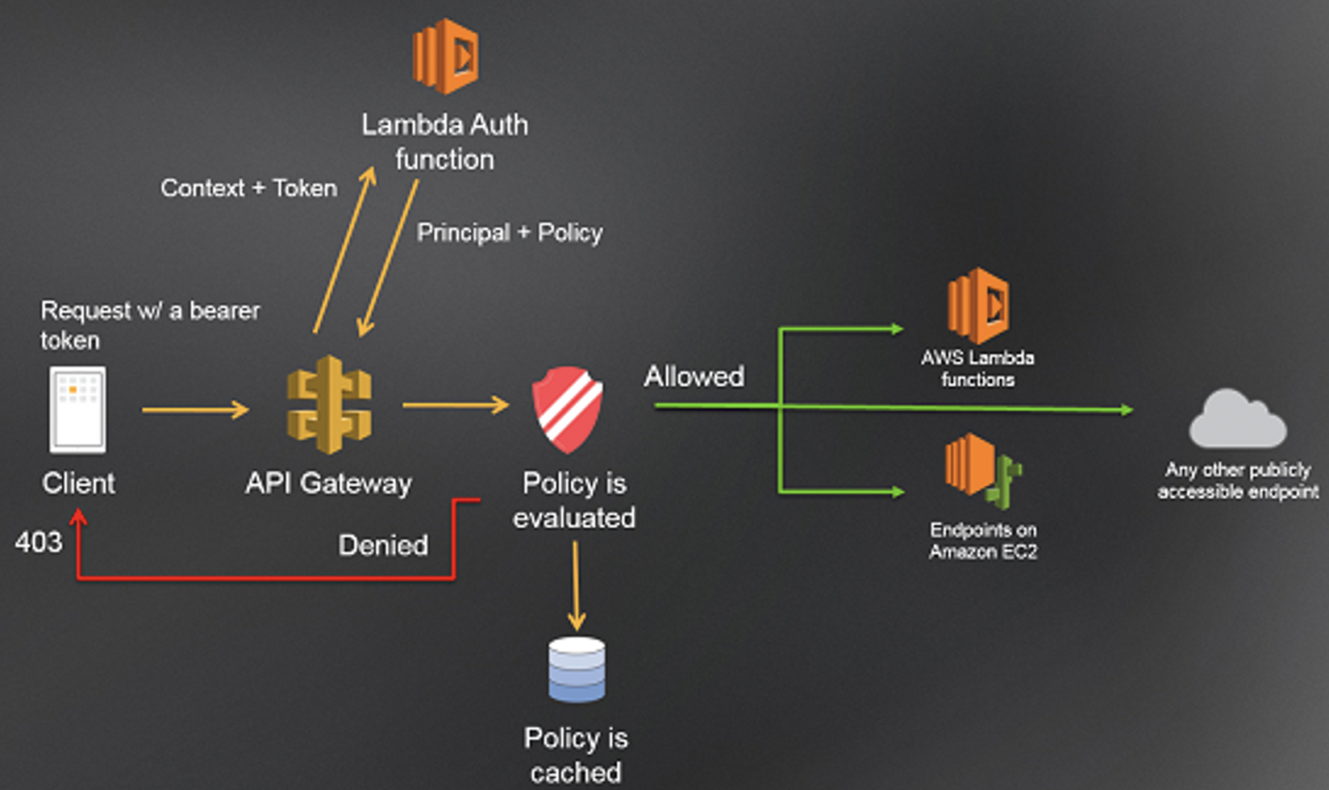
API Gateway Authorizer – Concept
We will do the simple
Register with email/PW.
Use middleware to
Require login.
Implement simple access control/authorization.
But, ... ...
Separation of Concerns
Leads to factoring things like:
Before middleware
After middleware
Out of the microservice and into a ”layer.”
So, we will also do a simple API Gateway Lambda authorizer

Slide 20
Single Site Image Certificate, DNS, CloudFront, API Gateway
20 | E6156 – Cloud Computing: Backend-as-a-Service

